Slide 1
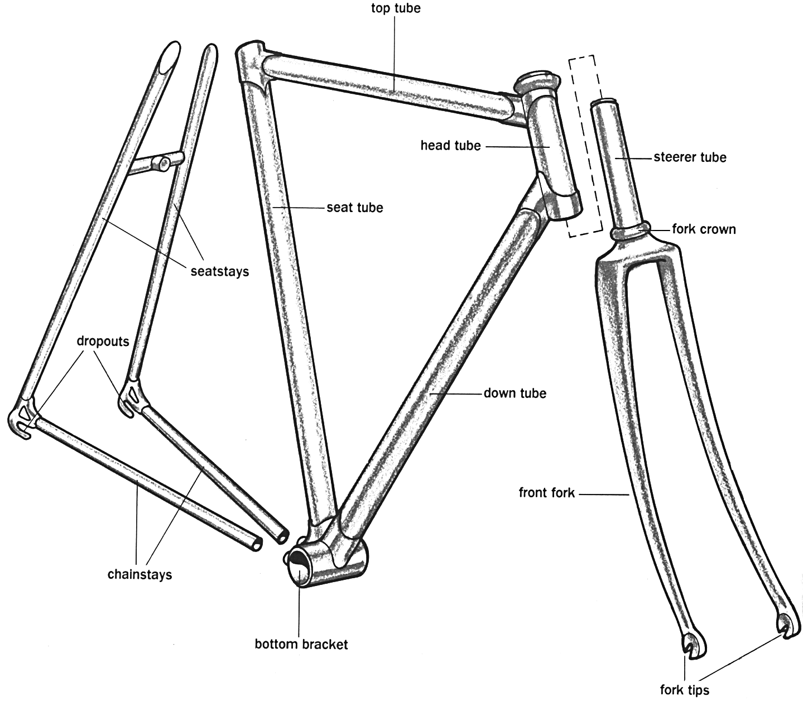
Bicycle Design and Construction
From Ref. 5, used by permission of
Rodale Press, ©1994, all rights reserved

Slide 2
Different Frame Construction Philosophies
Bicycle companies tend to have different design philosophies, to give them a unique market “niche”:
Cannondale - welded aluminum frames, hand crafted
Specialized - welded steel or chrome-moly (a steel alloy)
Trek - glued aluminum frames, or welded steel

Slide 3
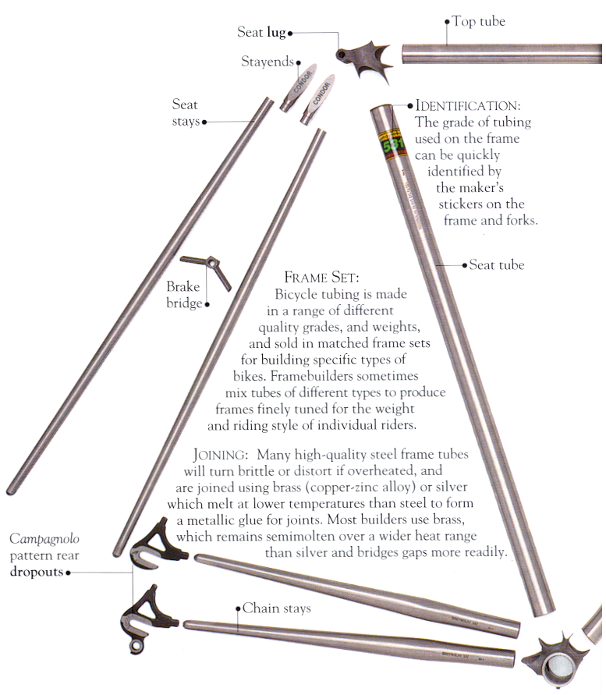
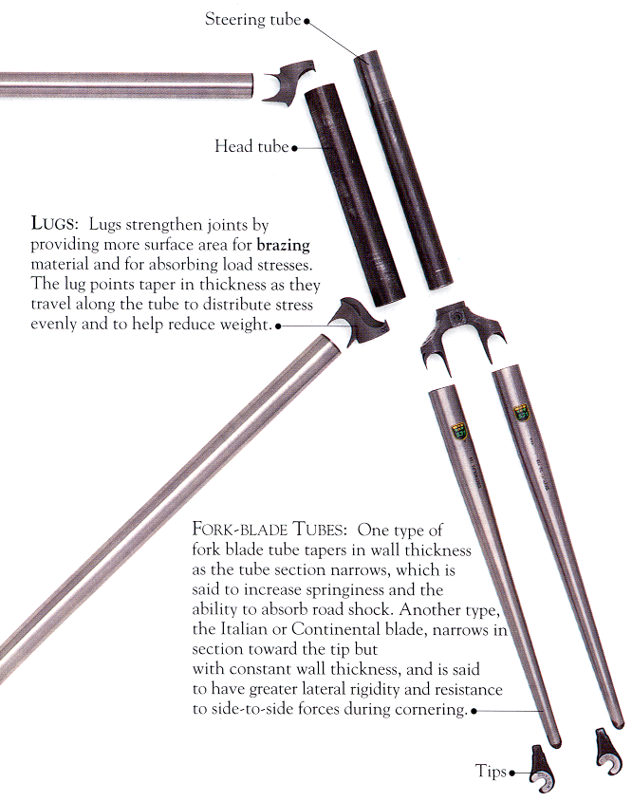
Frame
Components
from Ref. 3, used with permission of Dorling Kindersley, ©1992, all rights reserved

Slide 4
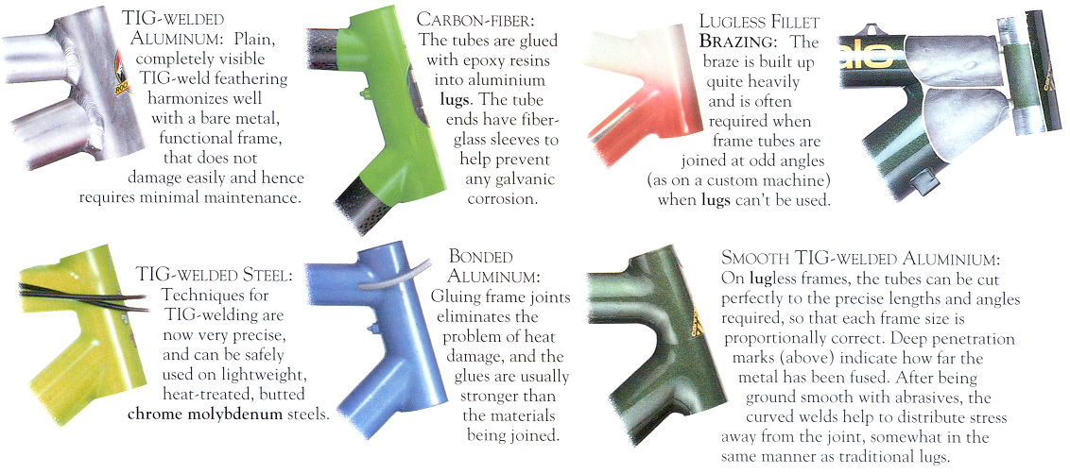
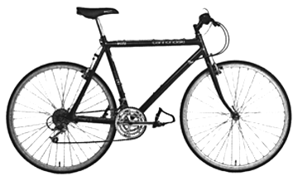
Joining Processes for Frame Tubing
from Ref. 3, used with permission of Dorling Kindersley, ©1992, all rights reserved
4

Slide 5

Cannondale Factory Tour - CAD
All of Cannondale’s bicycle frames are designed on high-tech CAD systems in the R&D department at the Bethel, Connecticut headquarters.
New frame designs are then sent via modem to the Cannondale factory in Bedford, Pennsylvania.
The following are excerpts from http://www.cannondale.com/factoryb/f2.html
5

Slide 6
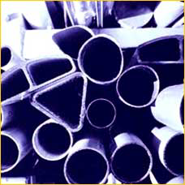
Cannondale Factory Tour - Raw Tubing
With the exception of carbon fiber/aluminum Raven models, all Cannondale bicycles are built from lightweight 6000 series aluminum tubes with different diameters, shapes, and wall thicknesses.
6000 series aluminum is used because it can be shaped and machined much easier than 7000 series aluminum or metal matrix aluminum compounds.

Slide 7
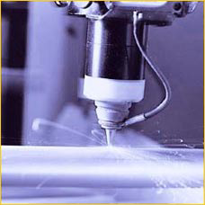
Cannondale Factory Tour - Laser Cutting
Computer guided lasers are used to precisely cut aluminum frame tubes to the proper length.
Selected tubes are also mitered to wrap around adjoining tubes.
The lasers provide a cleaner cut than traditional cutting methods and ensure incredibly tight tolerances for greater weld integrity and a stronger frame.

Slide 8
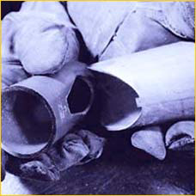
Cannondale Factory Tour - Tabs & Slots
The tubes on Cannondale frames feature a unique, patented tab-and-corresponding-slot design that aligns the tubes for welding.
By eliminating the need to build numerous production fixtures for each size and every new frame style, this tab-and-slot system dramatically reduces pre-production engineering chores and allows Cannondale to bring innovative new models to market with amazing speed.

Slide 9
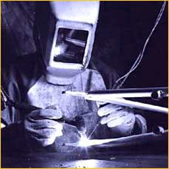
Cannondale Factory Tour - TIG Welding
The 6000 series aluminum frames are then TIG welded together by hand.
Welding the thin-walled 6000 series aluminum tubing used in cutting-edge bicycle frames is a surprisingly difficult art to master.

Slide 10
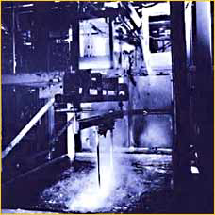
Cannondale Factory Tour - Heat Treating
Cannondale then heat-treats their frames to restore the tubes to their original strength after welding.
A frustratingly difficult (and expensive) process to perfect, heat-treating allows Cannondale to actually use less material to achieve the necessary levels of strength.
Many other manufacturers use thicker-walled tubing or reinforcing gussets, both of which add weight.

Slide 11
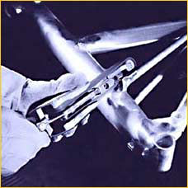
Cannondale Factory Tour - Sanding
Beyond the obvious aesthetic benefit, smooth, sanded welds help prevent stress-risers which can occur at the outer edge of an unfinished weld, where the weld abruptly ends and the tube wall is suddenly thinner and more prone to accumulated stresses.
The gradually tapering walls created by properly finished welds, however, disperse stresses over a wider area, allowing Cannondale to use thinner walled tubes for a lighter frame.

Slide 12

Cannondale Factory Tour -
For the most even, most consistent coverage possible, Cannondale paints their frames electrostatically whereby the frame carries a small electronic charge that actually attracts individual paint particles.
After painting, each frame has its decals applied and is clear-coated with a durable, protective finish.

Slide 13
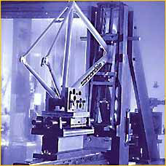
Cannondale Factory Tour - Testing
Cannondale has invested over a million dollars in their Q-Lab, an in-house testing facility for bicycle frames and components.
A new frame design typically spends more than two months undergoing five different batteries of tests:
1. fatigue testing,
2. impact testing,
3. finite element analysis testing,
4. computerized field testing, and
5. brittle-coat testing.

Slide 14
Look at one Simple Subsystem - Frame Tubing
Frame design is an excellent example of the trade-offs inherent in the design process and the sometimes arbitrary decisions (i.e., not justifiable based on purely analytical terms) which are often made
There are lots of possibilities (variables) for frame design:
  material (steel, aluminum, titanium, composite, ...)
  cross section shape
    shape (square, round, oval or other)
    hollow or solid
    constant cross section, or variable
How do you handle all this information and make a proper choice ?

Slide 15
Design Process
1. The first step in design - ASK QUESTIONS
  intended use of product
  desired or important performance qualities
    for bike - low weight, riding efficiency, comfort, durability, low cost ...
  potential failure modes
  how does the part fit into overall system
2. Identify design variables (things you as the designer can specify)

Slide 16
Design Process - continued
3. Quantify the performance qualities in terms of the design variables
4. Identify the constraints based on potential failure modes and performance qualities
5. Formulate a measure of the design’s “goodness” (quantitative if possible)

Slide 17
Design Process - continued
6. Apply an appropriate design method for choosing the actual values of the design variables:
  Trial and error (OK for simple problems)
  Past experience (extrapolation or interpolation)
  Intuition, dumb luck
  Numerical optimization methods (a necessity if the number of design variables and constraints are large)

Slide 18
Back to the Frame Tube
Let’s assume that the most important qualities of this tube are its:
  Low Flexibility (= high stiffness)
  Low Weight (want as light as possible)
  High Bending and Crush Strength
  Long Life
Design Variables:
  Material
  Wall thickness
  Tube OD
  Joining method (weld, glue, braze)

Slide 19
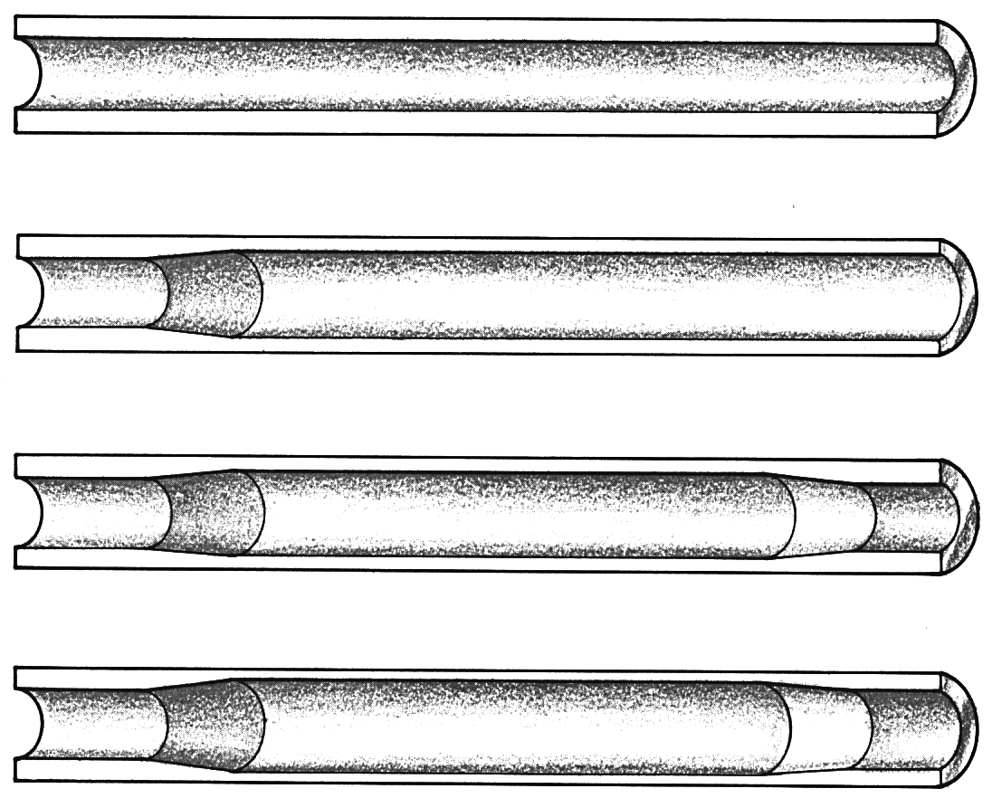
Bike Tubing
plain gage tube
Better tubes are thicker at ends to give greater strength at joints
single-butted tube
double-butted tube
triple-butted tube
From Ref. 5, used by permission of Rodale Press, ©1994, all rights reserved

Slide 20
Material Design Issues
Why does Cannondale use aluminum?
What are its advantages and disadvantages?
Other possibilities:
  Steels
    Low Carbon, High Carbon, Chrome-molybdenum, Stainless ...
  Titanium
  Magnesium
  Carbon fiber composite (Carbon Fiber, Kevlar)

Slide 21
Important Material Properties
Weight (density)
Stiffness (elastic modulus)
Strength (tensile strength, endurance limit)
Impact resistance (hardness)
Corrosion resistance
Joining methods
Recycling potential

Slide 22
Comparison of Material Properties
Elastic Yield Tensile Cost
Material Modulus Strength Strength Density Brinell [$/lb]
[Mpsi] [Kpsi] [Kpsi] [lb/in³] Hardness (in 1999)
Aluminum
6061 T6 10 40 45 .10 95 $1-$2.50
7075 T6 10 72 82 .10 150 $2-$3.60
Steel
1040 HR (med carbon) 30 42 76 .283 149 $0.25-$1
1040 CD 30 71 85 .283 170 “
4140 HR (chrome/moly) 30 63 90 .283 187 “
4140 CD 30 90 102 .283 223 “
Titanium 6-4 16.5 120-150 130-160 .16 N/A $13-$90
Graphite/Epoxy* 1-20 150 30-200 .06 N/A $5-$27
HR = Hot Rolled CD=Cold Drawn
* Actual properties depend on the type and amount of reinforcing material

Slide 23
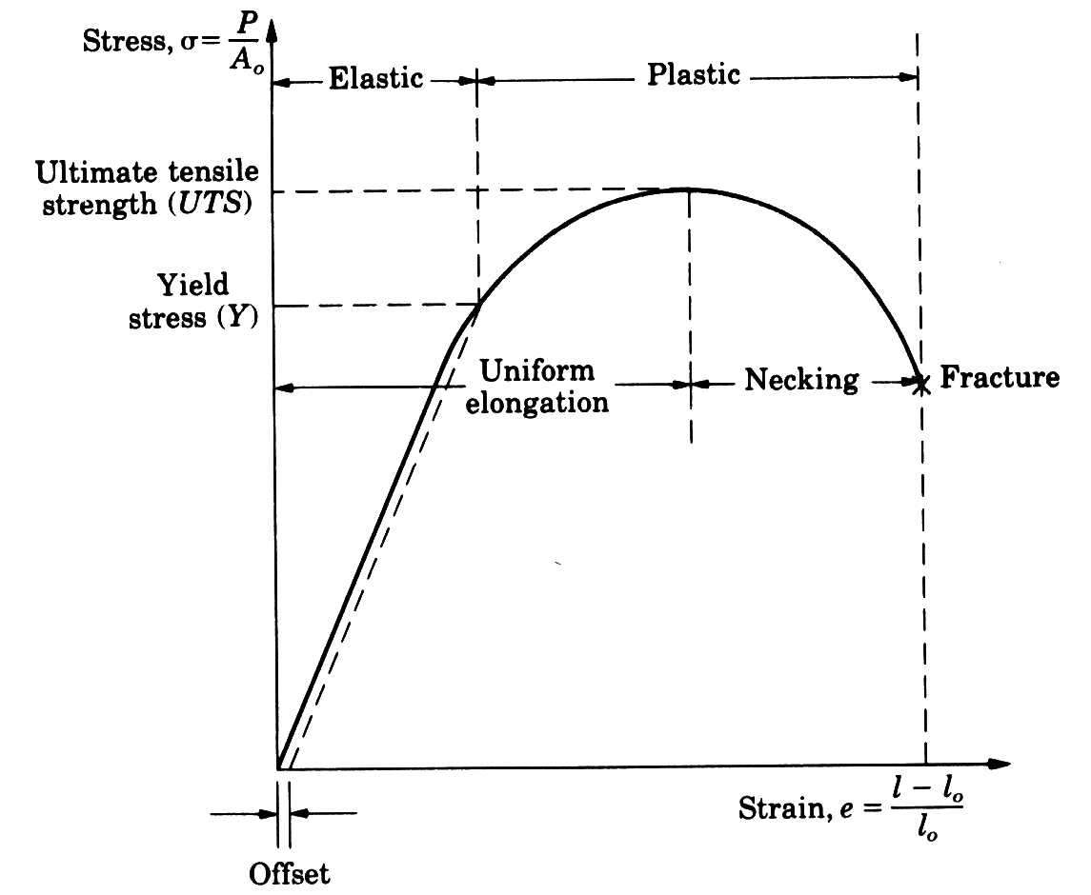
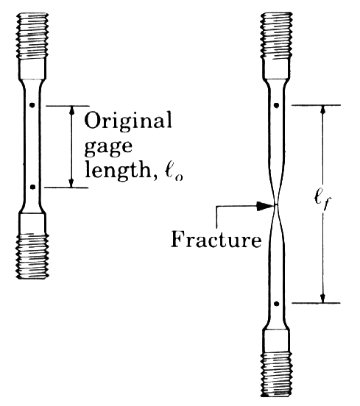
Static Strength
Results from a typical tensile test of a steel sample
from Manufacturing Engineering and Technology, by S. Kalpaakjian,
used by permission of Addison Wesley, ©1992, all rights reserved

Slide 24
Fatigue (Cyclic) Strength
Fatigue properties are very dependent on material type.
Steels have an endurance limit - a stress level which can be endured for an unlimited number of cycles (no fatigue).
Aluminum does not have an endurance limit and fatigues no matter what the stress level. Therefore, an aluminum bike must be built with extra strength to account for fatigue effects.
80
500
1045 Steel
Endurance Limit
Stress Amplitude, S (MPa)
Kpsi
2014-T6 Aluminum alloy
0
0
10³
10¹⁰
Number of Cycles, N

Slide 25
Cannondale Tube
Cannondale uses aluminum tubing, 1.75” OD, .085” constant wall thickness - a good compromise between weight and flexibility
OD - 1.75”
WEIGHT
FLEXIBILITY
0
0.05
0.1
0.15
0.2
0.25
WALL THICKNESS - inches

